Slide 1
SSZG 518: Database Design and Applications
Today’s Class
Normalization

Slide 2
OUTLINE
Normal Forms – 1NF, 2NF, 3NF
Inference Rules for FDs
Attribute Closure, FD Closure
BCNF
3NF vs BCNF

Slide 3
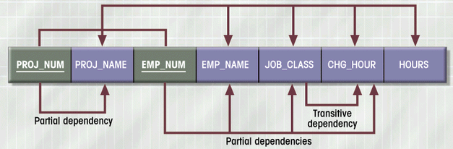
Dependency Diagram (1NF)
Figure 4.4

Slide 4
1NF Summarized
Each attribute must be atomic (single value)
No repeating columns within a row (composite attributes)
No multi-valued columns.
All key attributes defined
All attributes dependent on primary key
1NF simplifies attributes
Queries become easier.

Slide 5
Conversion to 2NF
Start with 1NF format:
Write each key component on separate line
Write original key on last line
Each component is new table
Write dependent attributes after each key
PROJECT (PROJ_NUM, PROJ_NAME)
EMPLOYEE (EMP_NUM, EMP_NAME, JOB_CLASS, CHG_HOUR)
ASSIGN (PROJ_NUM, EMP_NUM, HOURS)

Slide 6
Second Normal Form (2NF)
Each attribute must be functionally dependent on the primary key.
If the primary key is a single attribute, then the relation is in 2NF
The test for 2NF involves testing for FDs whose left-hand-side attribute are part of the primary key
Disallow partial dependency, where non-keys attributes depend on part of a composite primary key
In short, remove partial dependencies
2NF improves data integrity.
Prevents update, insert, and delete anomalies.

Slide 7
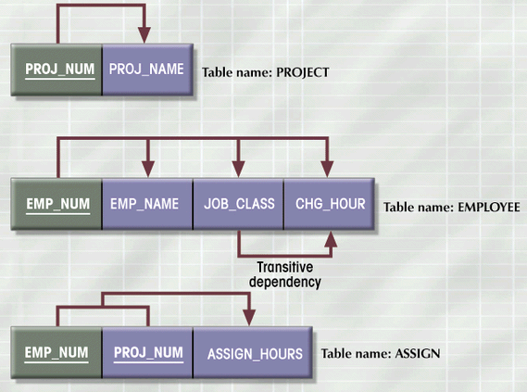
2NF Conversion Results
Figure 4.5

Slide 8
2 NF
Based on the concept of Full FDs (FFD)
If A & B are sets of attributes of R, B is said to be FFD on A if A➔B, but no proper subset of A determines B
No partial dependencies on the PK
Is PLOTS in 2NF?
YES
Single attribute PK
All relations with single attribute PK are in 2 NF!!
2 NF applies to relations with composite keys

Slide 9
2 NF
A relation that is in 1NF & every non-PK attribute is fully functionally dependent on the PK, is said to be in 2 NF
1 NF
Remove all
2 NF
Partial Dependencies

Slide 10
2NF Summarized
In 1NF
Includes no partial dependencies
No attribute dependent on a portion of primary key
Still possible to exhibit transitive dependency
Attributes may be functionally dependent on nonkey attributes

Slide 11
Conversion to 3NF
Create separate table(s) to eliminate transitive functional dependencies
PROJECT (PROJ_NUM, PROJ_NAME)
ASSIGN (PROJ_NUM, EMP_NUM, HOURS)
EMPLOYEE (EMP_NUM, EMP_NAME, JOB_CLASS)
JOB (JOB_CLASS, CHG_HOUR)

Slide 12
3 NF
Based on the concept of transitive dependency
No non-PK attribute should be transitively dependent on the PK
Transitive Dependency
If A➔B & B➔C, then A transitively determines C through B, provided B & C do not determine A
Is PLOTS in 3NF?
NO

Slide 13
3 NF
PLOTS
Prop# | State | Plot# | Area | Price | Tax_rate
FD1
PK
FD2
CK
FD3
FD4
Prop# transitively determines tax_rate through state
Prop# transitively determines price through area

Slide 14
3 NF
A relation that is in 1NF & 2 NF & no non-PK attribute is transitively dependent on the PK, is said to be in 3 NF
2 NF
Remove all
3 NF
Transitive Dependencies

Slide 15
Inference Rules for FD’s
A₁, A₂, …, A_{n} → B₁, B₂, …, B_{m}
Splitting rule
and
Combining rule
Is equivalent to
A₁, A₂, …, A_{n} → B₁
A₁, A₂, …, A_{n} → B₂
. . . . .
A₁, A₂, …, A_{n} → B_{m}
 | A1 | ... | Am |  | B1 | ... | Bm

Slide 16
Inference Rules for FD’s (continued)
A₁, A₂, …, A_{n} → A_{i}
Trivial Rule
where i = 1, 2, ..., n
 | A₁ | … | A_{m}
Why ?

Slide 17
Inference Rules for FD’s (continued)
Transitive Closure Rule
If
A₁, A₂, …, A_{n} → B₁, B₂, …, B_{m}
and
B₁, B₂, …, B_{m} → C₁, C₂, …, C_{p}
then
A₁, A₂, …, A_{n} → C₁, C₂, …, C_{p}
Why ?

Slide 18
 | A₁ | … | A_{m} |  | B₁ | … | B_{m} |  | C₁ | ... | C_{p}

Slide 19
Closure of a set of FDs
It is not sufficient to consider just the given set of FDs
We need to consider all FDs that hold
Given F, more FDs can be inferred
Such FDs are said to be logically implied by F
F⁺ is the set of all FDs logically implied by F
We can compute F⁺ using formal definition of FD
If F were large, this process would be lengthy & cumbersome
Axioms or Rules of Inference provide simpler technique
Armstrong’s Axioms

Slide 20
Inference Rules for FDs
Armstrong's inference rules:
IR1. (Reflexive) If Y ⊆ X, then X ➔ Y
IR2. (Augmentation) If X ➔ Y, then XZ ➔ YZ
(Notation: XZ stands for X U Z)
IR3. (Transitive) If X ➔ Y and Y ➔ Z, then X ➔ Z
IR1, IR2, IR3 form a sound & complete set of inference rules
Never generates any wrong FD
Generate all FDs that hold

Slide 21
Inference Rules for FDs
Some additional inference rules that are useful:
Decomposition: If X➔YZ, then X➔Y & X➔Z
Union: If X➔Y & X➔Z, then X➔YZ
Psuedotransitivity: If X➔Y & WY➔Z,then WX➔Z
The last three inference rules, as well as any other inference rules, can be deduced from IR1, IR2, and IR3 (completeness property)

Slide 22
Example
R = (A, B, C, G, H, I) F = { A → B A → C CG → H CG → I B → H}
some members of F⁺
A → H
by transitivity from A → B and B → H
AG → I
by augmenting A → C with G, to get AG → CG and then transitivity with CG → I
CG → HI
By union rule

Slide 23
Procedure for Computing F⁺
To compute the closure of a set of functional dependencies F:
F ⁺ = F repeat for each functional dependency f in F⁺ apply reflexivity and augmentation rules on f add the resulting functional dependencies to F ⁺ for each pair of functional dependencies f₁and f₂ in F ⁺ if f₁ and f₂ can be combined using transitivity then add the resulting functional dependency to F ⁺ until F ⁺ does not change any further
NOTE: We shall see an alternative procedure for this task later

Slide 24
Example on Computing F+
• F = {A → B, B → C, C D → E }
• Step 1: For each f in F, apply reflexivity rule
– We get: CD → C; CD → D
– Add them to F:
• F = {A → B, B → C, C D → E; CD → C; CD → D }
• Step 2: For each f in F, apply augmentation rule
– From A → B we get: A → AB; AB → B; AC → BC; AD→ BD;
ABC →BC; ABD → BD; ACD →BCD
– From B → C we get: AB → AC; BC → C; BD → CD;
ABC → AC; ABD → ACD, etc etc.
• Step 3: Apply transitivity on pairs of f’s
• Keep repeating… You get the idea

Slide 25
Reasoning About FDs
Example:
Contracts(contract_id, supplier, project, dept, part, qty, value)
and:
– C is the key: C → CSJDPQV
– Project purchases each part using single contract: JP → C
– Dept purchases at most one part from a supplier: SD → P
• JP → C, C → CSJDPQV imply JP → CSJDPQV
• SD → P implies SDJ → JP
• SDJ → JP, JP → CSJDPQV imply SDJ → CSJDPQV

Slide 26
Reasoning About FDs
• Computing the closure of a set of FDs can be expensive.
(Size of closure is exponential in # of attrs!)
• Typically, we just want to check if a given FD X →Y is in
the closure of a set of FDs F. An efficient check:
– Compute attribute closure of X (denoted X+) wrt F:
• Set of all attributes Z such that X → Z is in F+
• There is a linear time algorithm to compute this.
– Check if Y is in X+
• Does F = {A → B, B → C, C D → E } imply A → E?
– i.e, is A → E in the closure F+? Equivalently, is E in A+?

Slide 27
Closure of Attribute Sets
Closure of a set of attributes X with respect to F is the set X⁺ of all attributes that are functionally determined by X
X⁺ can be calculated by repeatedly applying IR1, IR2, IR3 using the FDs in F

Slide 28
Closure of Attribute Sets
Given a set of attributes α, define the closure of α under F (denoted by α⁺) as the set of attributes that are functionally determined by α under F
Algorithm to compute α⁺, the closure of α under F
result := α; while (changes to result) do for each β → γ in F do begin if β ⊆ result then result := result ∪ γ end

Slide 29
Example of Attribute Set Closure
R = (A, B, C, G, H, I)
F = {A → B, A → C, CG → H, CG → I, B → H}
(AG)⁺
1. result = AG
2. result = ABCG (A → C and A → B)
3. result = ABCGH (CG → H and CG ⊆ AGBC)
4. result = ABCGHI (CG → I and CG ⊆ AGBCH)
Is AG a candidate key?
Is AG a super key?
Does AG → R? == Is (AG)⁺ ⊇ R
Is any subset of AG a superkey?
Does A → R? == Is (A)⁺ ⊇ R
Does G → R? == Is (G)⁺ ⊇ R

Slide 30
Uses of Attribute Closure
There are several uses of the attribute closure algorithm:
Testing for superkey:
To test if α is a superkey, we compute α^{+,} and check if α⁺ contains all attributes of R.
Testing functional dependencies
To check if a functional dependency α → β holds (or, in other words, is in F⁺), just check if β ⊆ α⁺.
That is, we compute α⁺ by using attribute closure, and then check if it contains β.
Is a simple and cheap test, and very useful
Computing closure of F
For each γ ⊆ R, we find the closure γ⁺, and for each S ⊆ γ⁺, we output a functional dependency γ → S.

Slide 32
Computing F+
• Given F={ A → B, B → C}. Compute F+ (with
attributes A, B, C).
We’ll do an example on A+.
Step 1: Result = A
Step 2: Consider A → B, Result = A ∪ B = AB
Consider B → C, Result = AB ∪ C = ABC
Step 3: A+ = {ABC}

Slide 36
Database Normalization
Boyce-Codd Normal Form (BCNF)
A relation is in Boyce-Codd normal form (BCNF) if every determinant in the table is a candidate key.
(A determinant is any attribute whose value determines other values with a row.)
If a table contains only one candidate key, the 3NF and the BCNF are equivalent.
BCNF is a special case of 3NF.

Slide 37
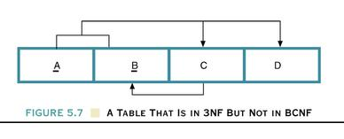
A Table That Is In 3NF But Not In BCNF

Slide 38
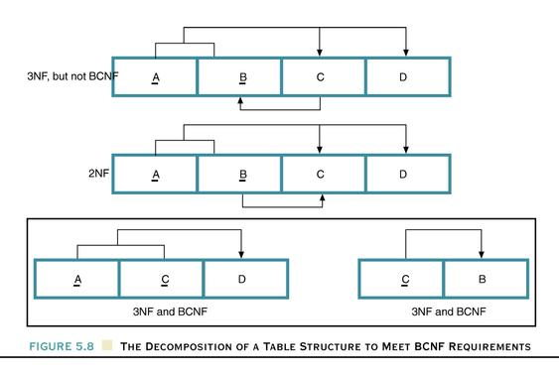
The Decomposition of a Table Structure to Meet
BCNF Requirements

Slide 39
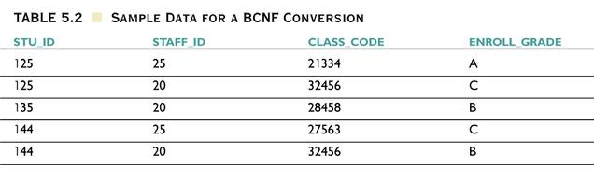
Sample Data for a BCNF Conversion

Slide 40
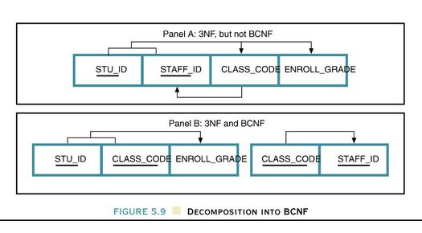
Decomposition into BCNF

Slide 41
BCNF
Based on FDs that take into account all candidate keys of a relation
For a relation with only 1 CK, 3NF & BCNF are equivalent
A relation is said to be in BCNF if every determinant is a CK
Is PLOTS in BCNF?
NO

Slide 42
BCNF vs 3NF
BCNF: For every functional dependency X->Y in a set F of functional dependencies over relation R, either:
Y is a subset of X or,
X is a superkey of R
3NF: For every functional dependency X->Y in a set F of functional dependencies over relation R, either:
Y is a subset of X or,
X is a superkey of R, or
Y is a subset of K for some key K of R
N.b., no subset of a key is a key

Slide 43
3NF Schema
For every functional
dependency X->Y in a set F
of functional dependencies
over relation R, either:
Y is a subset of X or,
X is a superkey of R, or
Y is a subset of K for some key K of R
Client, Office -> Client, Office, Account
Account -> Office
Account | Client | Office
A | Joe | 1
B | Mary | 1
A | John | 1
C | Joe | 2

Slide 44
3NF Schema
For every functional
dependency X->Y in a set F
of functional dependencies
over relation R, either:
Y is a subset of X or,
X is a superkey of R, or
Y is a subset of K for some key K of R
Client, Office -> Client, Office, Account
Account -> Office
Account | Client | Office
A | Joe | 1
B | Mary | 1
A | John | 1
C | Joe | 2

Slide 45
BCNF vs 3NF
For every functional
dependency X->Y in a set F
of functional dependencies
over relation R, either:
Y is a subset of X or,
X is a superkey of R
Y is a subset of K for some key K of R
3NF has some redundancy
BCNF does not
Unfortunately, BCNF is not dependency preserving, but 3NF is
Account | Office
A | 1
B | 1
C | 2
Account | Client | Office
A | Joe | 1
B | Mary | 1
A | John | 1
C | Joe | 2
Lossless decomposition
Account -> Office
Account | Client
A | Joe
B | Mary
A | John
C | Joe
Client, Office -> Client, Office, Account
Account -> Office
No non-trivial FDs

